Slide 1


Subject Code: SIT-1205
Subject Name: Object Oriented Analysis and Design
Faculty Name: Dr.R.Jeberson Retna Raj
Dr.R.M Gomathi

Slide 2
UNIT 2 OBJECT ORIENTED METHODOLOGIES
Rumbaugh et al.’s Object Modeling Technique - Booch Methodology - Jacobson et al. Methodologies - Patterns - Framework - Unified approach - Unified Modeling Language:Static and Model - UML Diagrams - UML Class Diagram - UML Usecase Diagram - UML Dynamic Modeling - UML Extensibility - UML Metamodel.

Slide 3
UML Dynamic Modeling (Behavioral Diagram)
Interaction diagrams:
– Sequence diagrams
– Collaboration diagrams
Statechart diagrams
Activity diagrams

Slide 4
UML Dynamic Modeling (Behavioral Diagram)
Interaction diagrams:
Interaction diagrams describe how groups of objects collaborate to get the job done.
Interaction diagrams capture the behavior of a single use case, showing the pattern of interaction among objects.

Slide 5
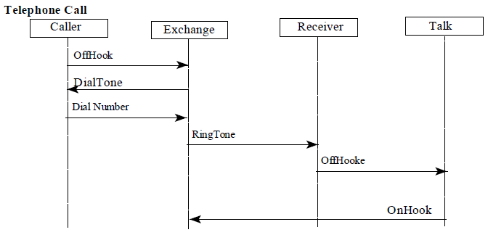
Interaction diagrams
UML Sequence Diagram
Sequence diagrams are an easy and intuitive way of describing the behavior of a system.
A sequence diagram shows an interaction arranged in a time sequence.

Slide 6
Interaction diagrams
UML Sequence Diagram
Two lines
Object participating in the interaction by their life lines
Message they exchanged, arranged in a time sequence.
Vertical life line : object life line
Horizontal life line : represents different object

Slide 7
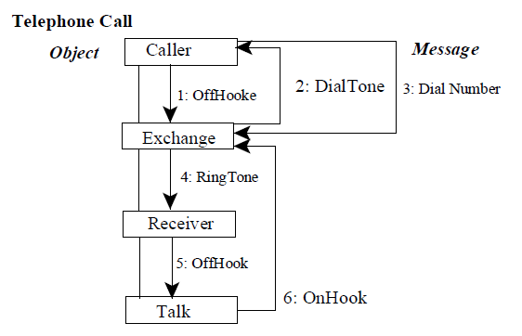
Collaboration Diagram
Represents a collaboration
Is a set of object related in a particular context.
Sequence is indicated by numbering the messages.
The exchange of their messages to achieve a desired outcome.

Slide 8
UML State Chart Diagram (state diagram)
A statechart diagram (also called a state diagram) shows the sequence of states that an object goes through during its life in response to outside stimuli and messages.
State chart diagram may contains sub diagrams.
Represents state of the method execution
State is represented as a rounded box, which may contain one or more compartments.
Name compartment → contains optional state
Internal transition compartment →hold a list of internal actions
Two special events entry/exit are reserved words
Entry /action expression
Exit /action expression

Slide 9
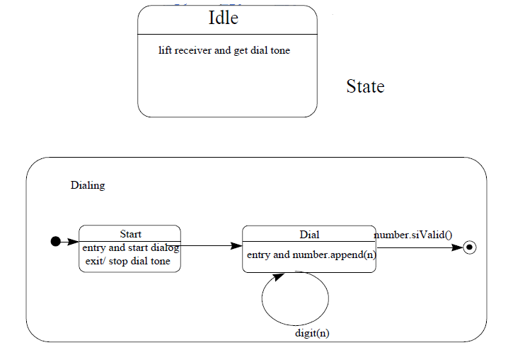
UML State Chart Diagram (state diagram)
statechart diagram :
Example : Nested state

Slide 10
Activity Diagram
Used to model an entire business process.
Provide flows and what is going on inside a use case.
Used to represent a class’s methods implementation
Same as state chart
Blackdot represents operation
Round box containing the name of the operation.
Outgoing solid arrow indicate transition triggered by completion of activity.
Synchronization bar for incoming and outgoing arrows.

Slide 11
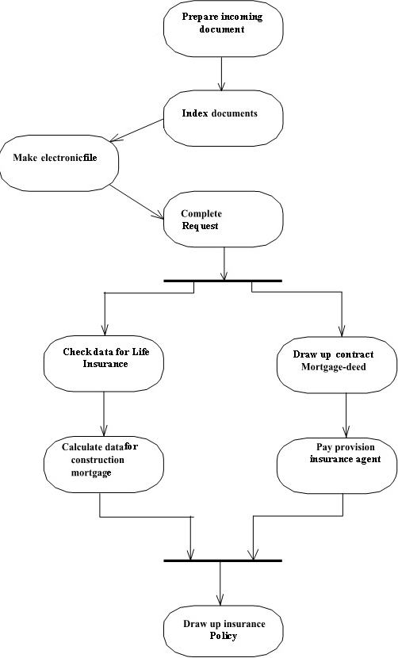
UML
Activity diagrams:

Slide 12
Implementation Diagram
These diagrams show the implementation phase of systems development.
Such as the source code structure and the run-time implementation structure.
There are two types of implementation diagrams:
– Component diagrams show the structure of the code itself.
– Deployment diagrams show the structure of the run-time system.

Slide 13
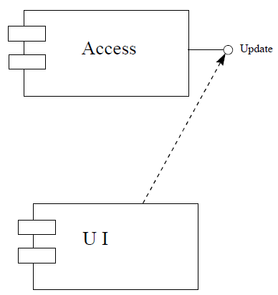
Component diagram
Model physical component (such as source code, executable program, user interface ) in a design.
User interface may contain many off-the-shelf components.
Packages → used to group logical components of the application.

Slide 14
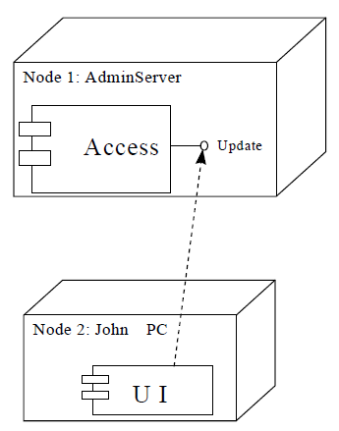
Deployment Diagram
Configuration of run time processing elements and software components, processes, and objects that live in the system.

Slide 15
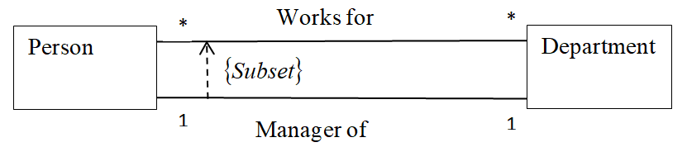
UML Extensibility
1. Model Constraints and comments
Some constraints such as association OR constraints are predefined in the UML.
Constraints are shown in { }
Constraints may be written in a natural language.
Constraints may be a “Comment” in a text form.
For class or association path, the constraints string may be placed near the symbol name.
Example : Constraint is shown as dashed arrow from one element to another

Slide 16
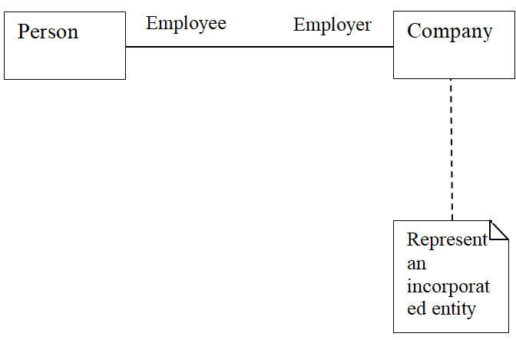
UML Extensibility
2.Note
Graphic Symbol containing textual information
Rectangle with
“bent corner in the upper right corner.

Slide 17
UML Extensibility
3.Stereo types
Represents builtin extensibility mechanism in UML.
User defined extensions of UML are enabled through the use if stereotype and constraints.
Subclass of existing modeling element with attributes, relationship with different intent.
Uses matched guillemets “<<“ “>>” such as flow. Ie double angle bracket.
Figure can be used in one or two ways.

Slide 18
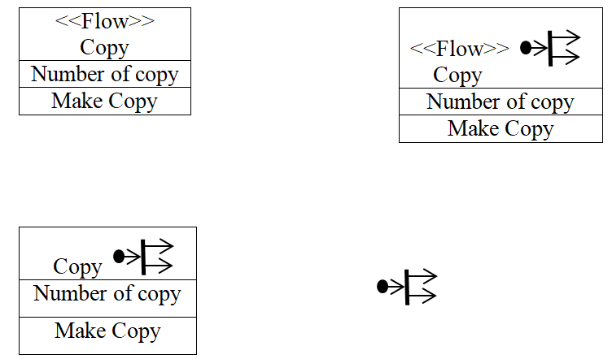
UML Extensibility Mechanism
Shortcoming
Make the model less universal
Not easily interchangeable with other tools.

Slide 19
UML Meta model
To describe a model itself.
Is a model of modeling elements.
Provide mean to connect different UML diagrams
Assume consistency among diagrams
Can serve as a means to exchange data between different CASE tools
UML notation not only to describe the system components, but also to describe a model itself. This is known as metamodel.
Model of modeling elements

Slide 20
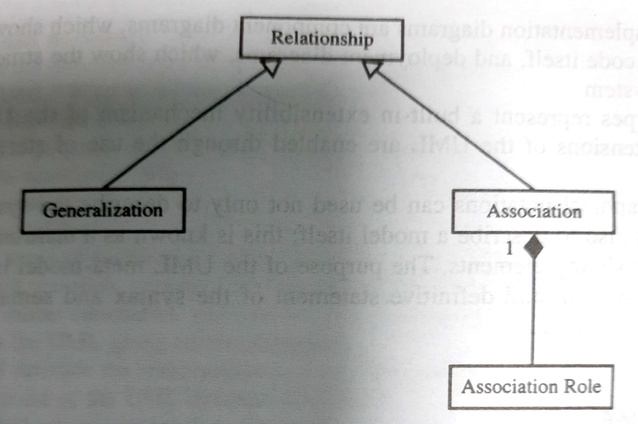
UML Meta model

Slide 21
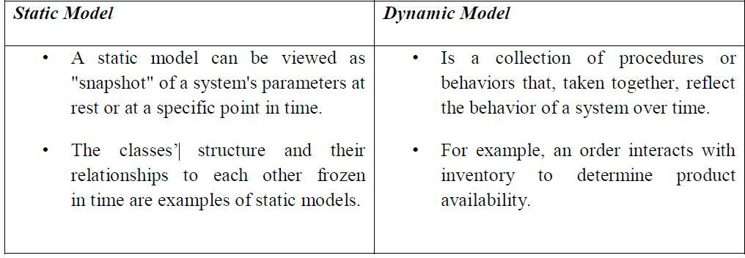
Static and Dynamic Model

